Slide 1


K.RAMAKRISHNAN COLLEGE OF TECHNOLOGY
(AUTONOMOUS), TRICHY
Hospital Management System
PRESENTED BY
2303811724321007-ABINESH R
Notes:
null

Slide 2
PRESENTATION OVERVIEW
Problem Identification
Objective
Proposed System
Block Diagram of Proposed System
Advantages of Proposed System
Modules
Module Description
Screenshots
Conclusion and Future Enhancement
Notes:
null

Slide 3
PROBLEM IDENTIFICATION
Manual patient records lead to errors and inefficiencies in hospital operations.
Scattered data across systems complicates access and management of patient information.
Manual appointment scheduling causes delays, conflicts, and missed appointments.
Lack of role-based access exposes sensitive patient data to security risks.
Absence of real-time updates hinders timely decision-making for patient care.

Slide 4
OBJECTIVE
Automate patient registration and profile management to reduce errors.
Centralize patient, doctor, and appointment data for efficient management.
Optimize appointment booking with treatment details and real-time checks.
Enhance security with role-based access control for patients and doctors.
Generate automated reports using SQL queries for data-driven healthcare decisions.
Implement relational database schema to ensure data consistency and integrity.
Notes:
null

Slide 5
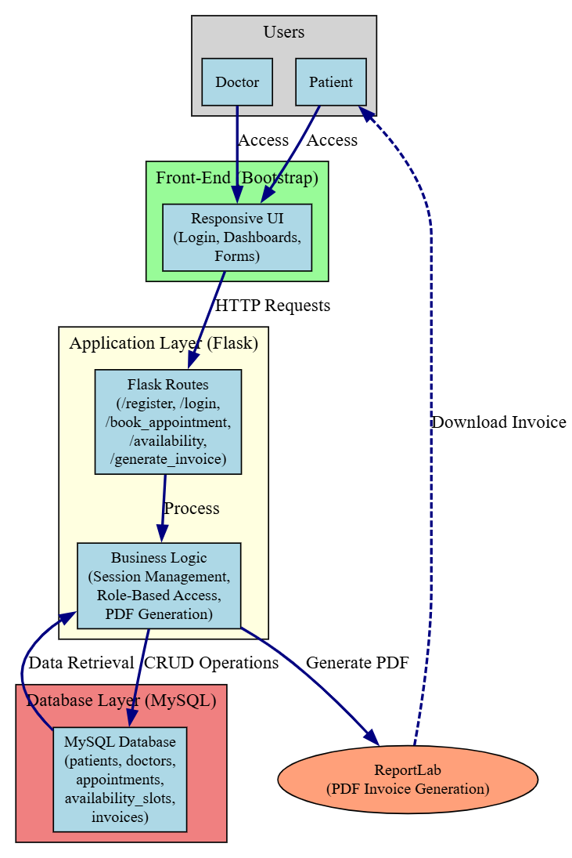
ARCHITECHTURE DIAGRAM
Notes:
null

Slide 6
PROPOSED SYSTEM
Web-Based Platform: A Flask-powered application with a user-friendly interface for hospital operations.
Database Integration: MySQL database to store patient, doctor, and appointment data, ensuring centralized and secure management.
Patient Management: Register and edit patient profiles with details like name, email, and password.
Appointment Scheduling: Book and track appointments with doctor selection, date, and treatment details.
Security & Access Control: Role-based login for patients and doctors, with separate registration forms.
Dynamic Dashboards: Patient and doctor dashboards to view appointments and download invoices.
Notes:
null

Slide 7
ADVANTAGES OF PROPOSED SYSTEM
Increased Efficiency: Automates patient registration and appointment scheduling, reducing manual effort and errors.
Centralized Data Access: Stores all hospital data in a MySQL database for easy retrieval and management.
Enhanced Security: Role-based access ensures only authorized users view sensitive data.
Improved Patient Care: Real-time appointment and patient data access supports timely medical decisions.
User-Friendly Interface: Responsive dashboards and forms simplify navigation for patients and doctors.
Cost-Effective Solution: Uses lightweight Flask and MySQL, ensuring low maintenance for small hospitals.
Notes:
null

Slide 8
LIST OF MODULES
Patient Management Module
Appointment Scheduling Module
Security & Access Control Module
Database Module
User Interface Module
Notes:
null

Slide 9
MODULE DESCRIPTION
Patient Management Module: Handles patient registration and profile editing with details like name, email, and password.
Appointment Scheduling Module: Enables booking and tracking of appointments with doctor selection, date, and treatment details.
Security & Access Control Module: Provides role-based login (patient/doctor) and separate registration forms for secure access.
Database Module: Manages MySQL database with tables for patients, doctors, and appointments, using SQL CRUD operations and joins for efficient data retrieval.
User Interface Module: Provides responsive HTML/CSS/JavaScript dashboards, dynamically populated with MySQL data via Flask endpoints.
Notes:
null

Slide 10
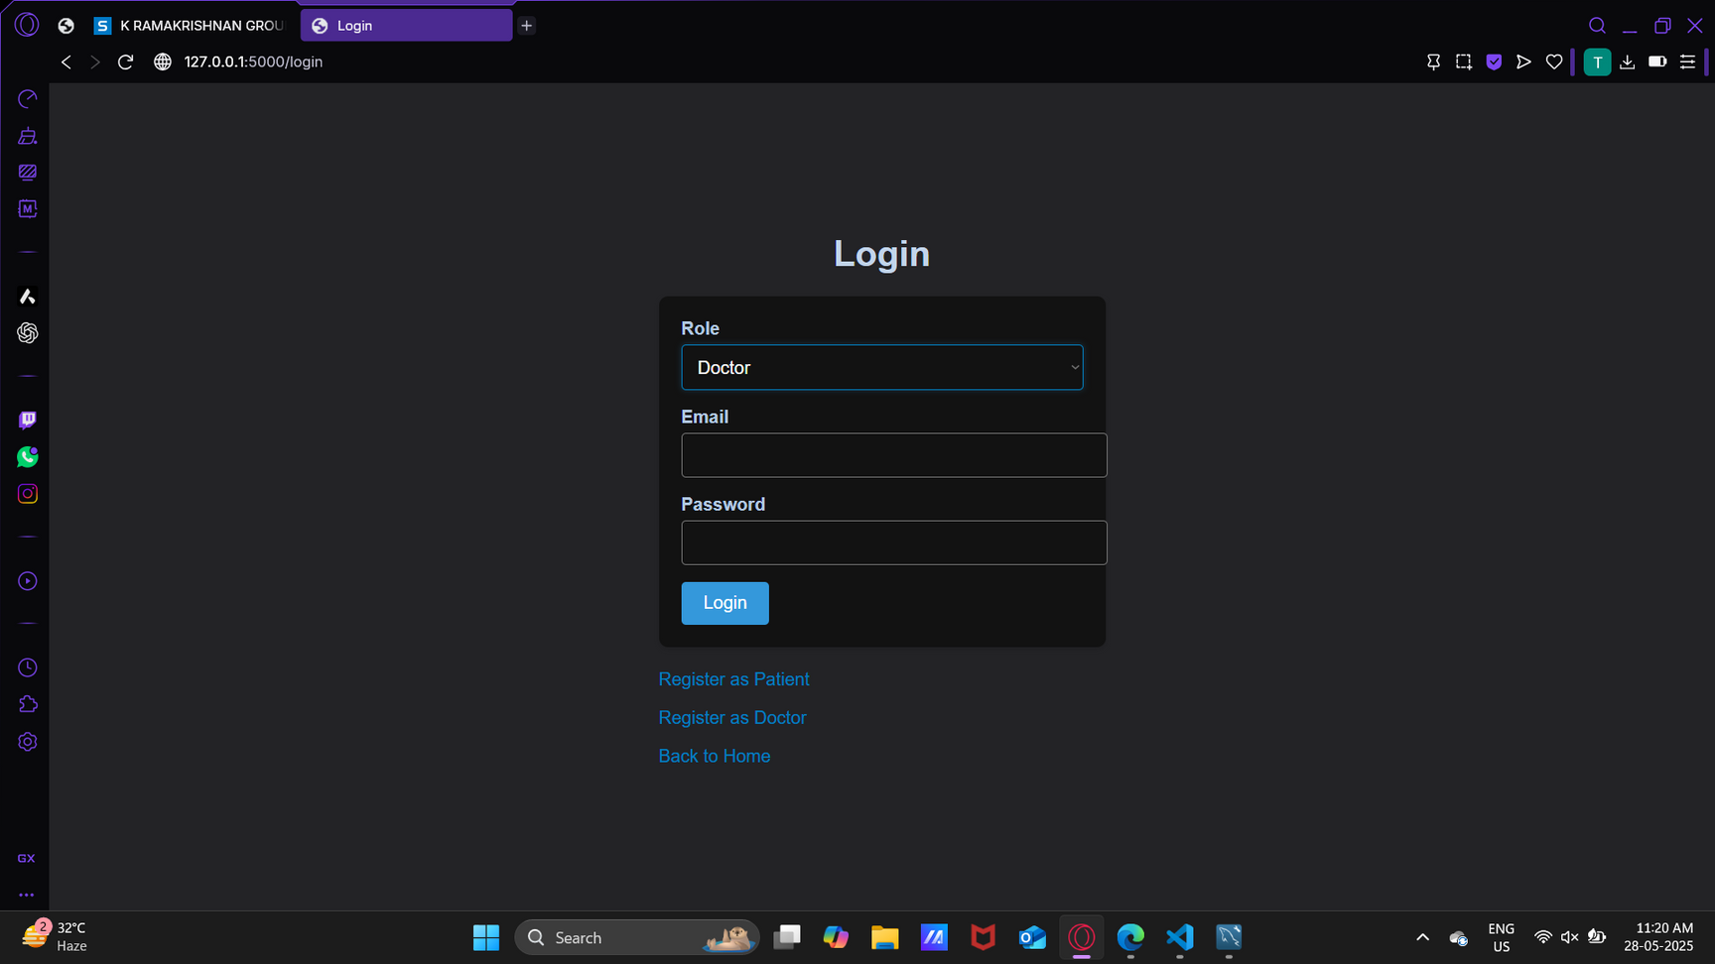
RESULT AND DISCUSSION
Notes:
null

Slide 11
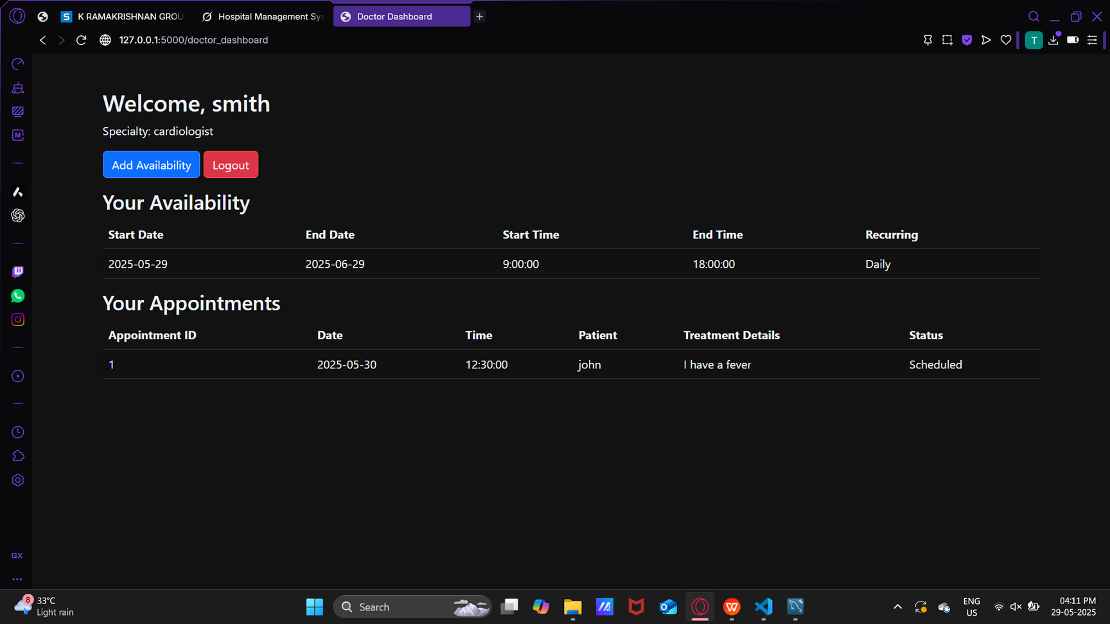
RESULT AND DISCUSSION (CONT)
Notes:
null

Slide 12
CONCLUSION AND
FUTURE ENHANCEMENT
Conclusion
The Hospital Management System (HMS) automates patient registration, appointment scheduling, and secure access control using Flask and MySQL. It centralizes data, reduces errors, and enhances patient care with real-time insights. Intuitive dashboards and role-based security ensure efficiency and safety. This project demonstrates DBMS principles through MySQL schema design, SQL query optimization, and data integrity in healthcare. Offering a scalable solution. Future enhancements like mobile apps will boost its impact.
Future Enhancements
Mobile App Integration: Develop iOS/Android apps for patient and doctor access.
Cloud Deployment: Host on cloud platforms for scalability and remote access.
Advanced Analytics: SQL-Based Analytics: Implement stored procedures for patient trend analysis and resource optimization.
Notes:
null

Slide 13
THANK YOU
Notes:
null

